Slide 1
IDEA 120: Week 1
January 11, 2021: Course Introduction

Slide 2
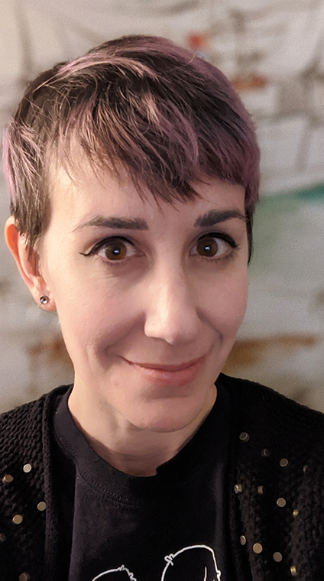
Welcome to IDEAS 120: Digital Practices in Design and Art!
I’m Dr. Tiffany Funk (but you can call me Tiffany).
I’m Visiting Assistant Professor of IDEAS (Interdisciplinary Education in the Arts).
I have researched and written about many topics in digital media, including computer art, video games, and performance. I’m also an artist—I’ve made websites, video games and installations, and teach studio courses on these mediums.
Each week I will post either a PowerPoint or video explaining important concepts and terms that will help you in your readings, assignments, and projects over the coming weeks.

Slide 3
This week, you are expected to read over the syllabus, and read the first assigned text for the semester: Rachel Green’s “Web Work– A History of Net Art.” These can all be found on the course schedule, on Github: https://github.com/IDEA-120/Course-Materials/blob/Spring2021/SCHEDULE.md
Take note of the following TERMS:
NET.ART
HTML
Rhizome (www.rhizome.org)
cyberfeminism
desktop
web browser
ASCII
bot
Hacktivism (or “tactical media”)

Slide 4
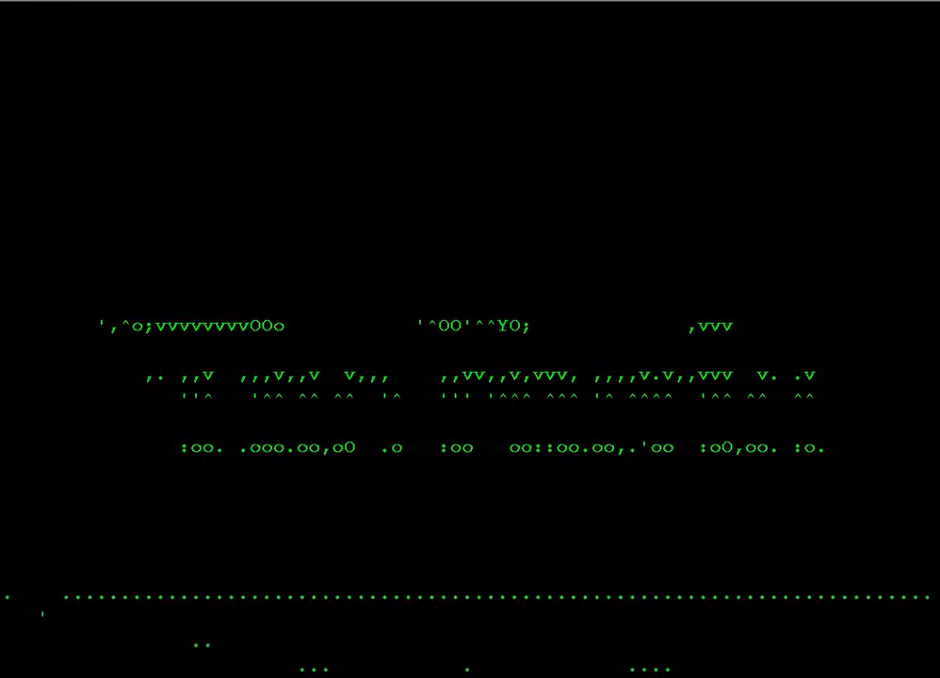
Vic Cosic
People to take note of:
Slovenian net artist known for his ASCII film series (he rendered the porn film Deep Throat and Hitchcock’s The Birds into ASCII characters)

Slide 5
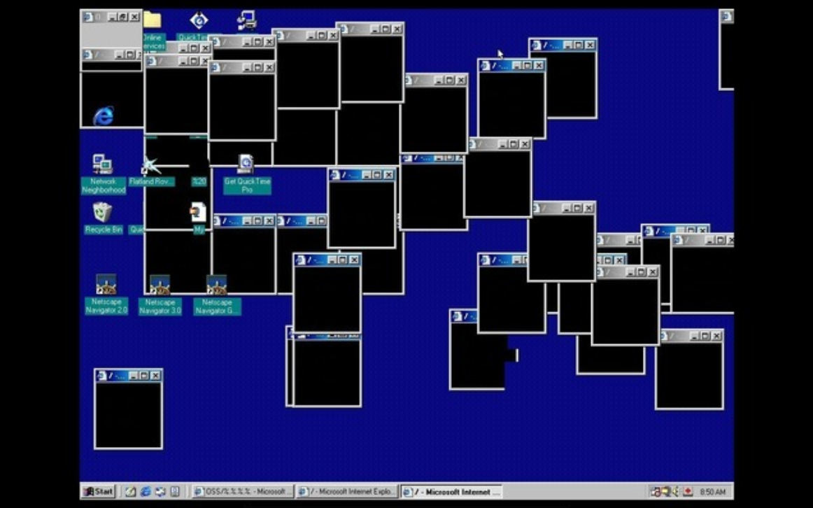
JODI (Dirk Paesmans and Joan Heemskerk)
People to take note of:
The artist duo JODI creates work that often exposes the programming or remixes the familiar icons and symbols of the internet to make them strange and unfamiliar. It formed a "punk" protest of software capitalism and the immense amount of money invested in internet and application development.
JODI, OSS, 2000, website

Slide 6
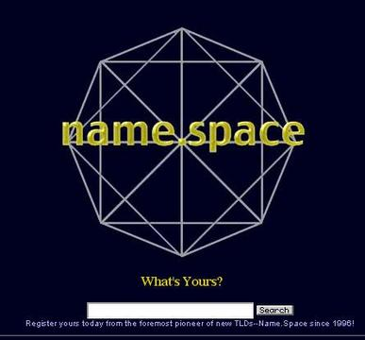
Paul Garrin, Name.Space, 1991
Artworks to take note of:
The logic of Name.Space was that if there were a more expansive set of names for websites, it would be more difficult for corporations or individuals to monopolize Web addresses. (keep in mind, the URL choices were fewer at this point; .com, .net, .co.uk, .edu, etc.)

Slide 7
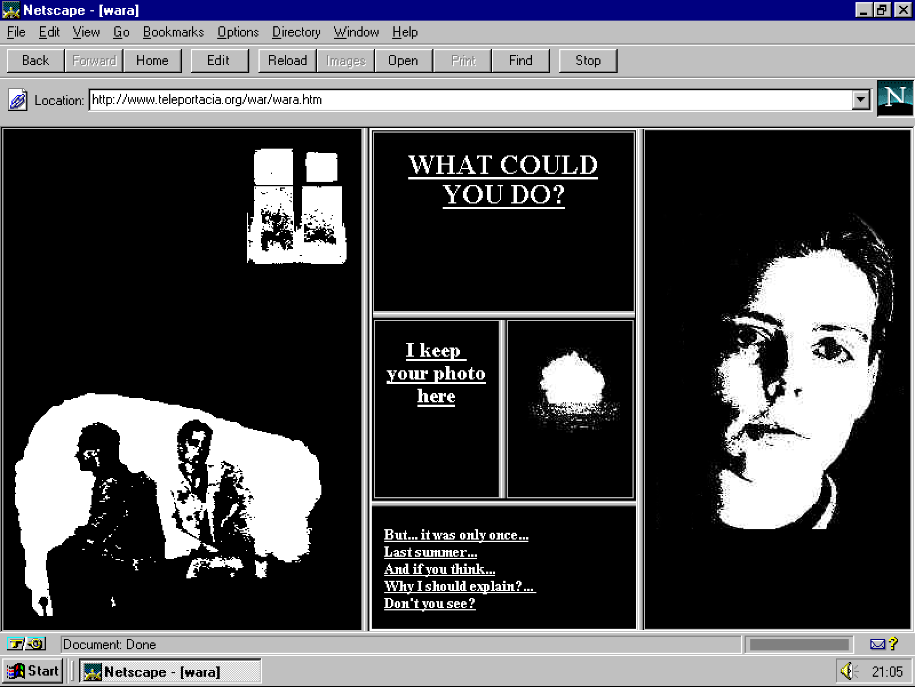
Olia Lialina, My Boyfriend Came Back From the War, 1996 https://anthology.rhizome.org/my-boyfriend-came-back-from-the-war
Artworks to take note of:
A filmic narrative of romance. It makes extensive use of "frame" programming, allowing users to populate their screens with frames subdividing into more frames, creating new combinations of text and images. It reimagines film space, but gives the "montage" control to the viewer.

Slide 8
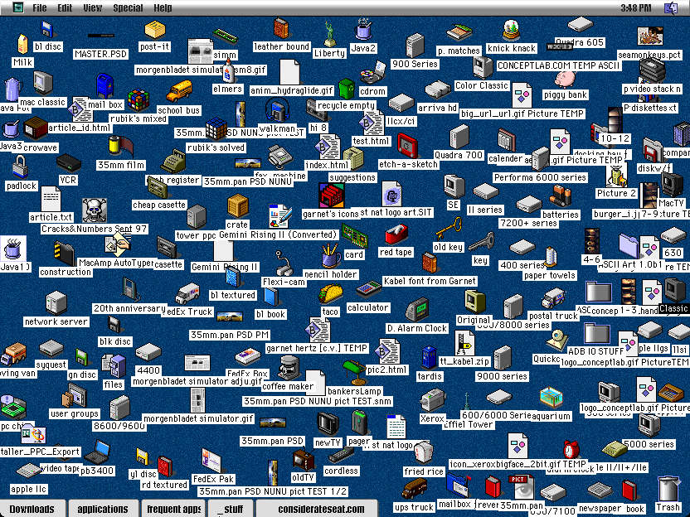
Desktop Is (1997) https://archive.nytimes.com/www.nytimes.com/library/cyber/mirapaul/121897mirapaul.html
Artworks to take note of:
Art show in which participants submitted screen shots of their CPU's desktop. Alexei Shulgin, the curator, reasoned that the desktop is a psychological space that performs as the user's "friend," through work and play.

Slide 9
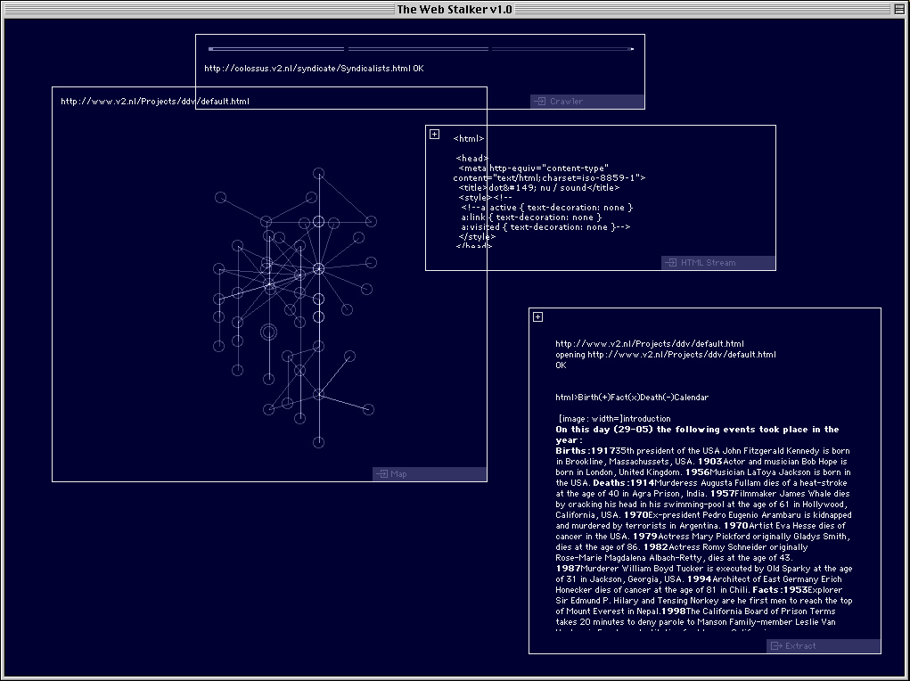
I/O/D, Web Stalker (1997) https://v2.nl/archive/works/the-web-stalker
Artworks to take note of:
Alternative web browser that, instead of showing the web page as intended, would instead show all of the external links from any given HTML page.

